Slide 1
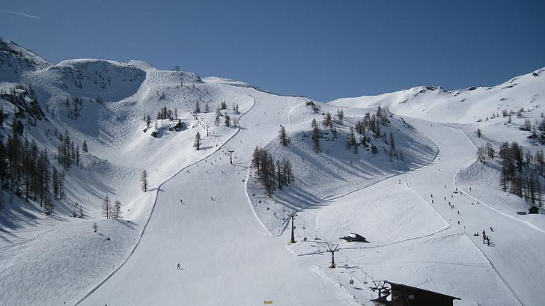
Big Mountain Resort
A guided Capstone

Slide 2
Problem Identification
Can Big Mountain Resort find ways to capitalize on it’s facilities to accommodate the $1,540,000 increase in operating costs by the end of the season by cutting costs without undermining ticket prices or increasing ticket prices?
Context
Big Mountain Resort has recently decided to purchase another chairlift to help visitors get around the mountain more efficiently to their operations. This caused an increase in operation costs, concerned for their revenue this season, they want to find a way to cut costs or to raise ticket prices.
Criteria for Success
The resort has increased revenue and has no issue handling the increased amount for operation costs after issuing the change(s) suggested.

Slide 3
Problem Identification Continued
Scope of Solution Space
Look through the data is see if any other resorts are similar in terms of location, number of lifts, number runs, days open, and pricing . Ideally, the resort would be able to increase the ticket price on weekends to be at least $10 more than it is currently. If not, then check to see if having the resort be open by maybe a week or two will provide an improved cost.
Constraints
May need specific user access to a database or S3 bucket
The resort may not want to raise weekend prices, as the resort is already charging above the average price compared to other Montana resorts.
Stakeholders
Director of Operations, Jimmy Blackburn,
Alesha Eisen, the Database Manager.
Key Data Sources
The CSV file with 330 US ski resorts that are considered to be in the same market share.

Slide 4
Recommendation and Key Findings
Based on the most favorable features of ski resorts, it appears that Big Mountain Resort can raise their ticket prices. Their original ticket price was $81, while the expected price is $95.87.
Our findings conclude
• That if the resort were to drop 1 or 2 runs the price and revenue would not change much, dropping 3 means the resort could drop 4 or 5 since the price and revenue would not drop substantially, dropping 6 runs or more would result insignificant revenue and ticket price drop.
• If the resort added a run, increased the vertical drop by 150 ft, added in the additional chairlift,and increased 2 acres of snow-making would result in support $1.99 of increased ticket price and by the end of the season, would produce $3,474,638.
• The resort could also increase their longest run by 0.2 miles and increasing snow making acres to be 4 acres would result in no price change.

Slide 5
Exploratory Data Analysis
In this section, we used PCA( principle components analysis) to find correlations between resort features and ticket prices.
While there were two states with higher PCA scores, it was decided that since there was not any concerning patterns, we would base our model on all states being considered equally.
In terms of correlations, a heatmap shows us that ticket prices correlate most with Runs, total_chairs, snow_making_ac, and fastQuads. By dividing the features into scatterplots with ticket prices as the y-axis, we see a strong correlation with Vertical drop, total chairs, runs and fastQuads.

Slide 6
Preprocessing and training data
We want to split our data into 70/30 partitions to best assess which model would best suit this problem.
To do this we must turn to metrics for some calculations. R², our coefficient of determination, this will be our measure of the proportion of variance given our dependent variable(ticket price). Where if R²= 0 means it will return the mean and R² = 1 means it can perfectly predict expected values. The mean of absolute error is just the average of errors and will tell how off the ticket price may be. Mean squared error is for optimizing machine learning models.
For our linear model, we have to choose the number of features that will provide the best performance. The number of features that works best for the linear model is 8.

Slide 7
Model Results
The linear model results with the top 4 features resorts have are fastQuads, total_chairs, snow_Making_ac, and vertical_drop. These results are consistent with the results in Exploratory data analysis.
For comparison, we also look at the Random Forest Model, where the results of top 4 features are the same as the linear model. Now to choose the best model, we use our metrics.
The result of comparing the linear model metrics to the random forest model metrics are that the absolute mean error of the Random Forest model is just about $1 less, and also have less variability. Therefore we used the Random Forest Model to reach our recommendations and key findings.

Slide 8
Conclusion
By using PCA techniques and finding important correlations between resort features and ticket price, splitting our data to train and assess models, and by selecting the model with less variability and the lower absolute mean error, we can see that Big Mountain resort has the necessary features to increase ticket price to around $95 if the business so desired, or if they want to cut costs instead, the resort could drop around 5 of the least used runs without undermining current ticket prices.

